Slide 1
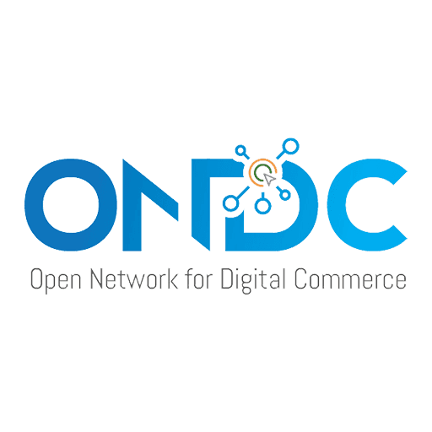
UNDERSTANDING ONDC – THE NEXT UPI

Slide 2
Introduction
Open Network for Digital Commerce (ONDC).
ONDC is to be based on open-sourced methodology.
Consumers can potentially discover any seller, product or service by using any compatible application or platform, thus increasing freedom of choice for consumers
ONDC would standardize operations, promote inclusion of local suppliers, drive efficiencies in logistics and lead to enhancement of value for consumers.

Slide 3









THE
PLANING
TEAM

Slide 4
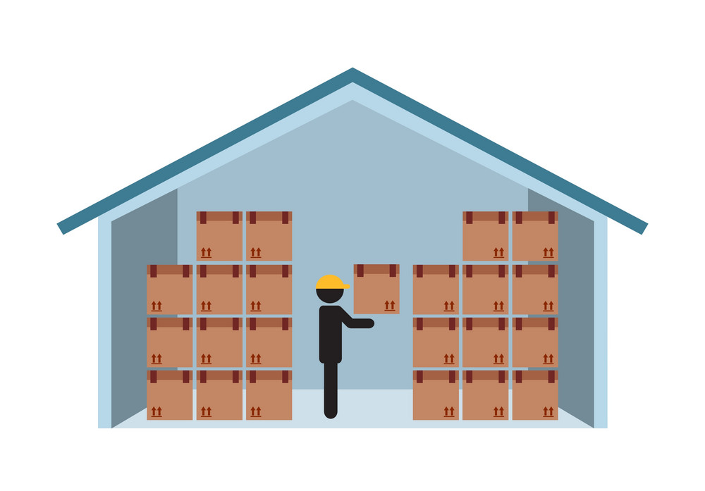
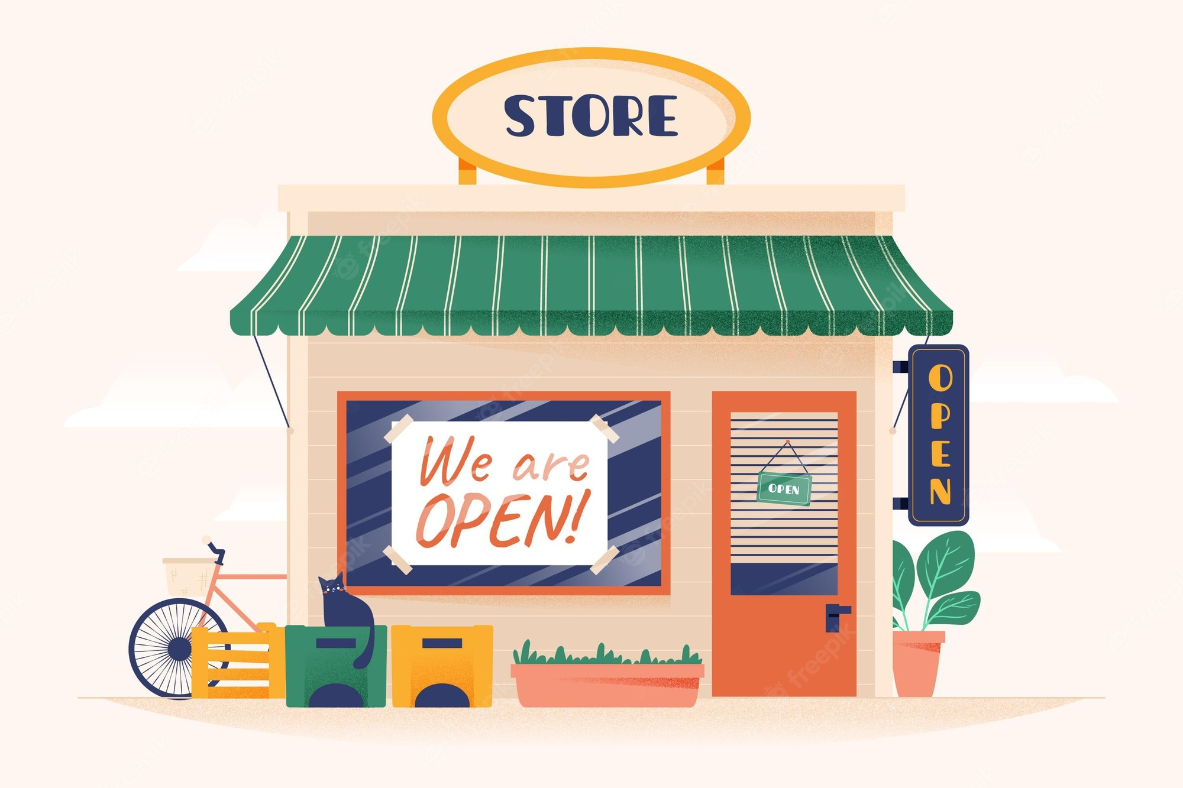

Why it introduced
INVENTORY MODEL

Slide 5
Need of ONDC
To promote micro and small worker
Deep discounting
Imitation game of various ecommerce platform

Slide 6






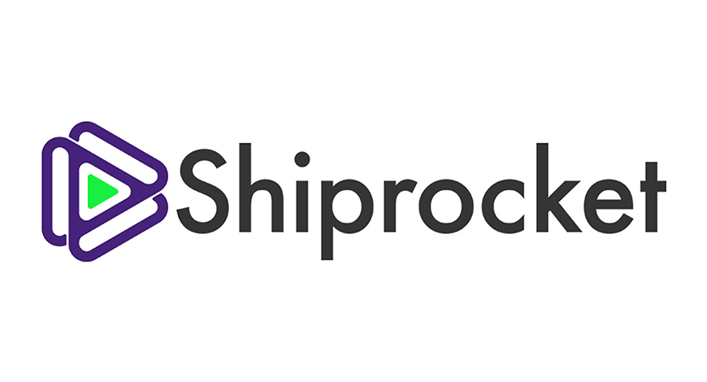


ONDC Stakeholders

Slide 7
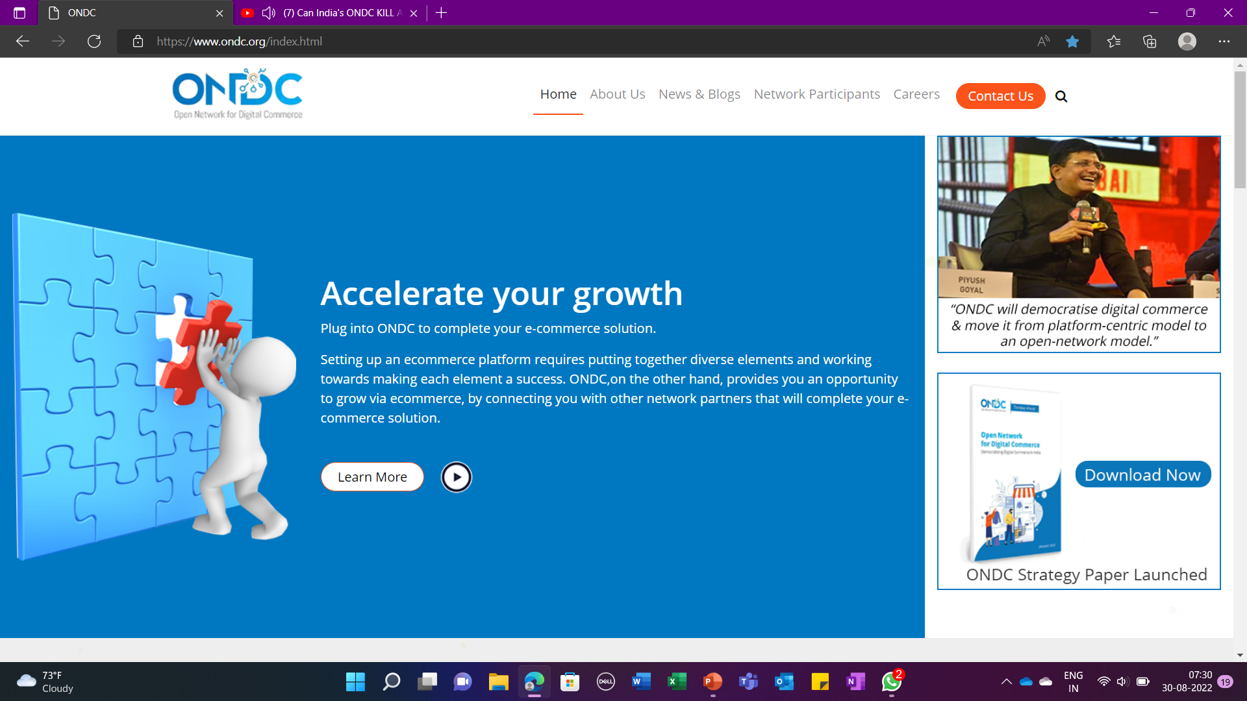

Slide 8
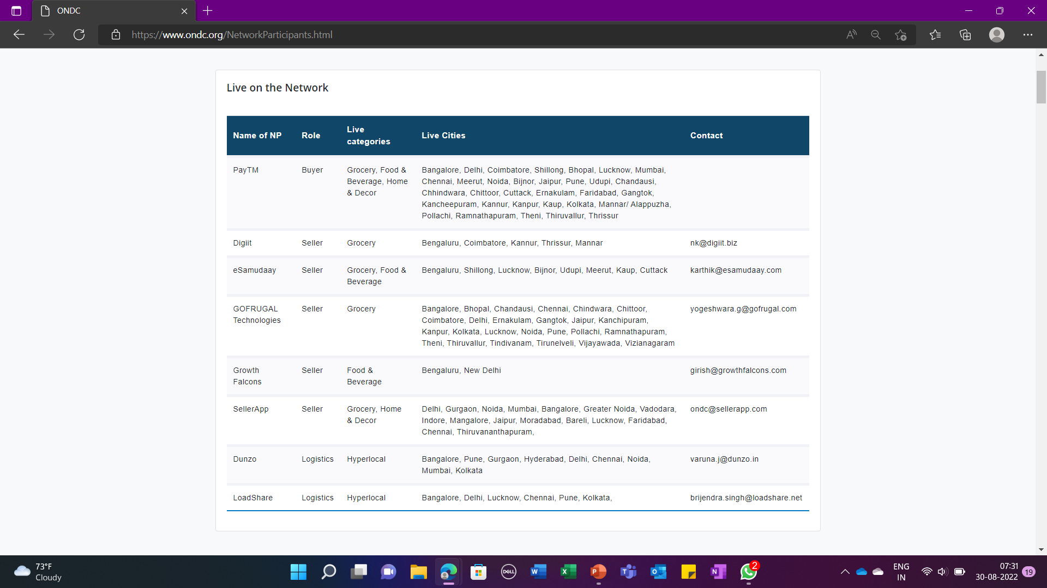

Slide 9

Connect Buyers to Network
Any technical/telecom interface that allows a buyer to search for a seller for the product they want, add to cart and complete the purchase. Such an interface options include but are not limited to
A mobile app
A desktop app
A website/webpage
A messaging platform
Interactive voice response (IVR)

Slide 10
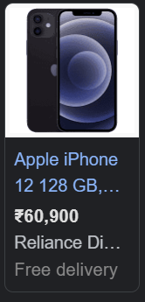
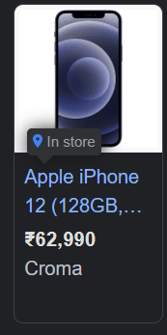
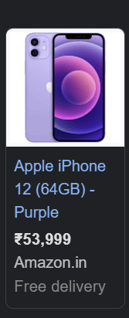
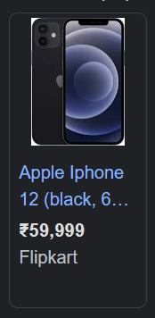
Future Plans

Slide 11
Understanding ONDC
Not a website , but an api.
It an open source app integration.

Slide 12
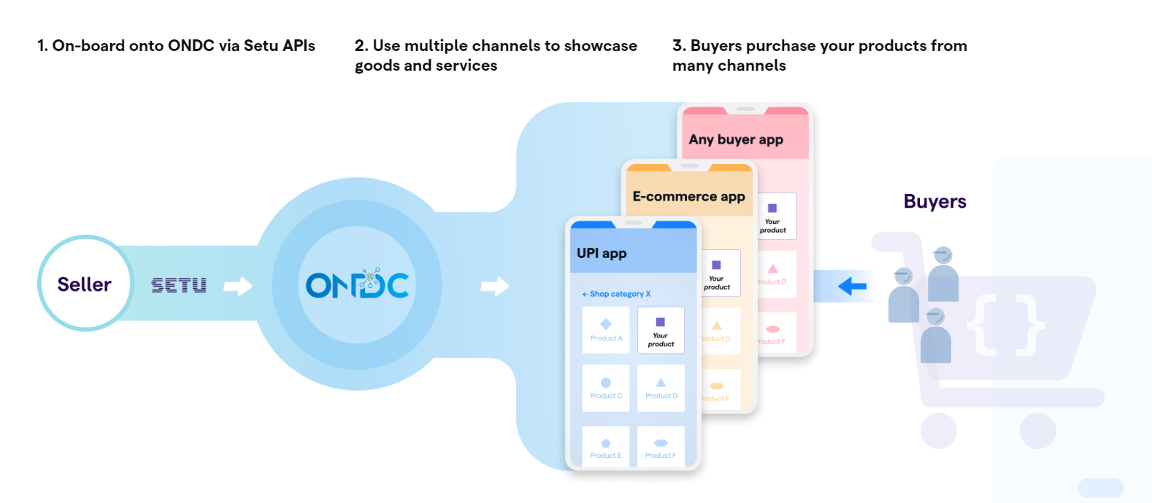

Slide 13
ONDC
Discoverability
Open protocol for ecommerce platform & interoperability
Price comparison

Slide 14
References
ONDC Project (pib.gov.in) ONDC
(7) Can India's ONDC KILL Amazon, Flipkart & Zomato? : ONDC Business Case Study - YouTube

